Slide 1
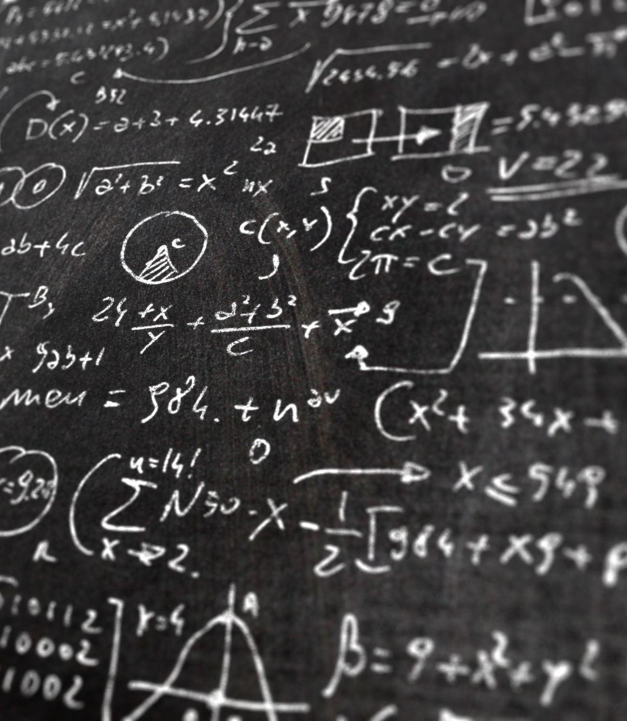
Math Concepts in Colab
Data Analytics Department Bridgerland Technical College

Slide 2
Lecture using Colab
In the next files, you will find different screenshots showing how to use Scikit-Learn in Colab.
01
Read and analyze the information given in the next slides
02
You will find a blank template on Canvas so you can create your own version of that lecture information provided
03

Slide 3
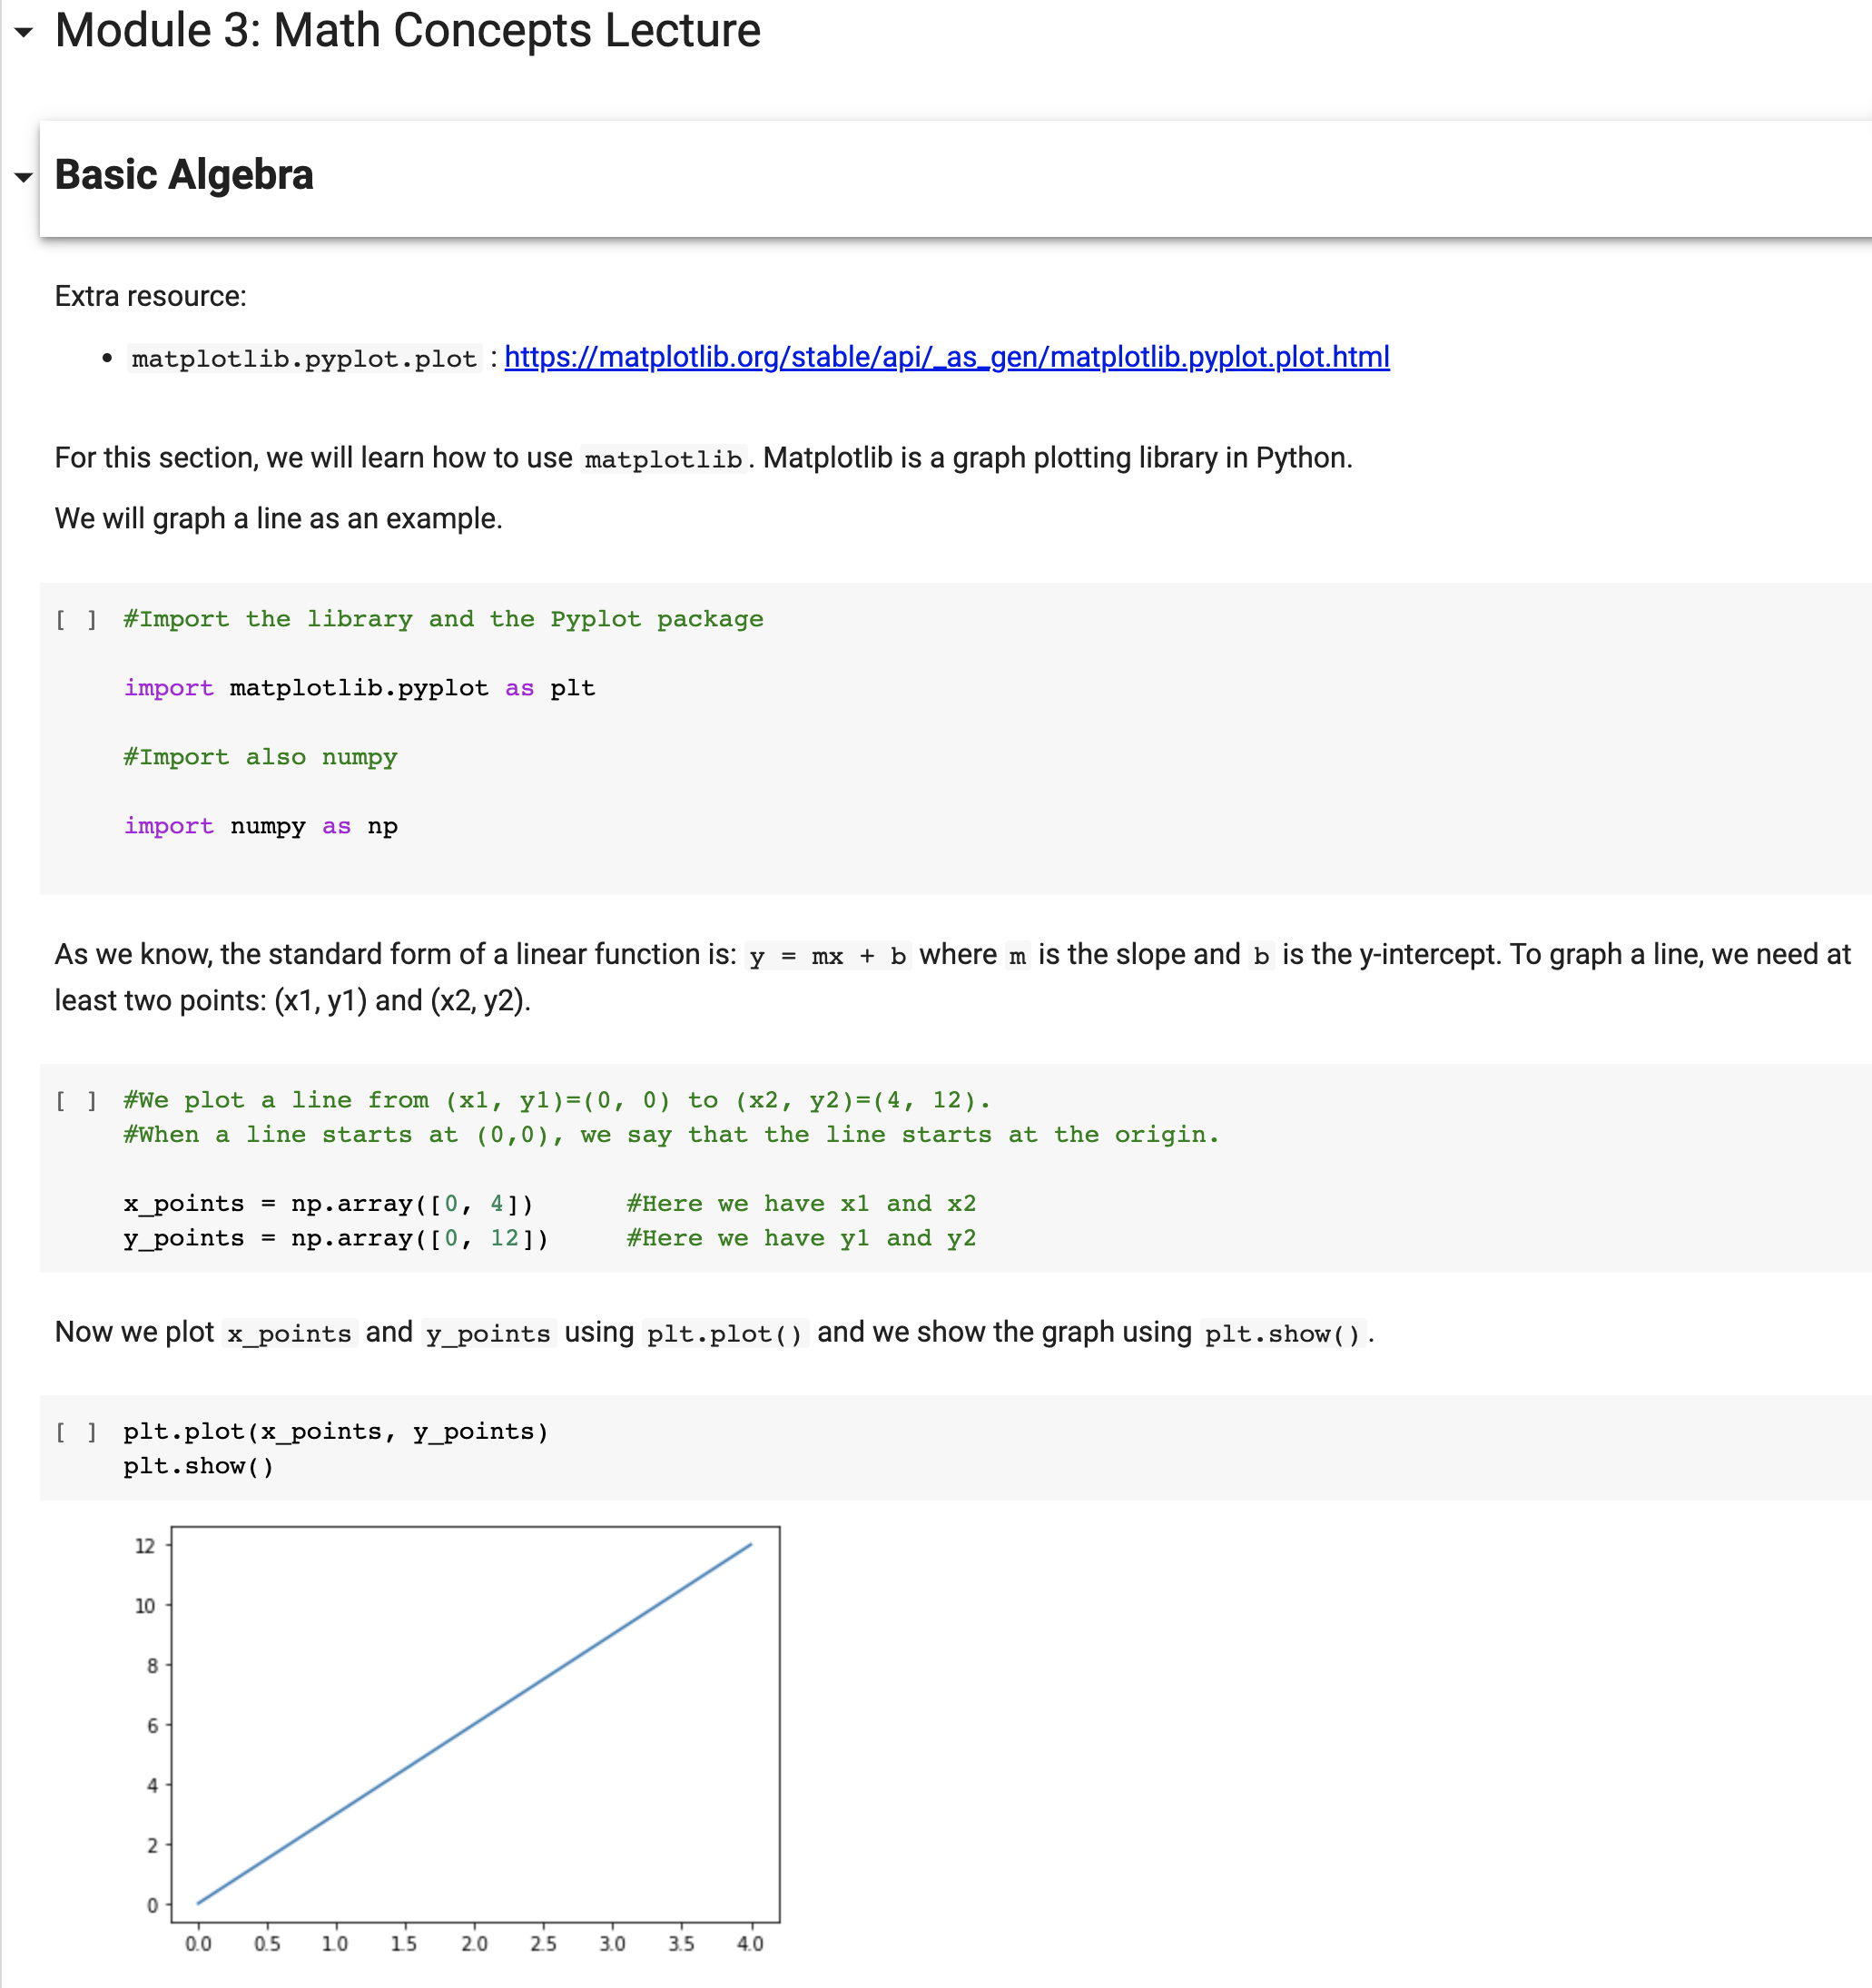

Slide 4
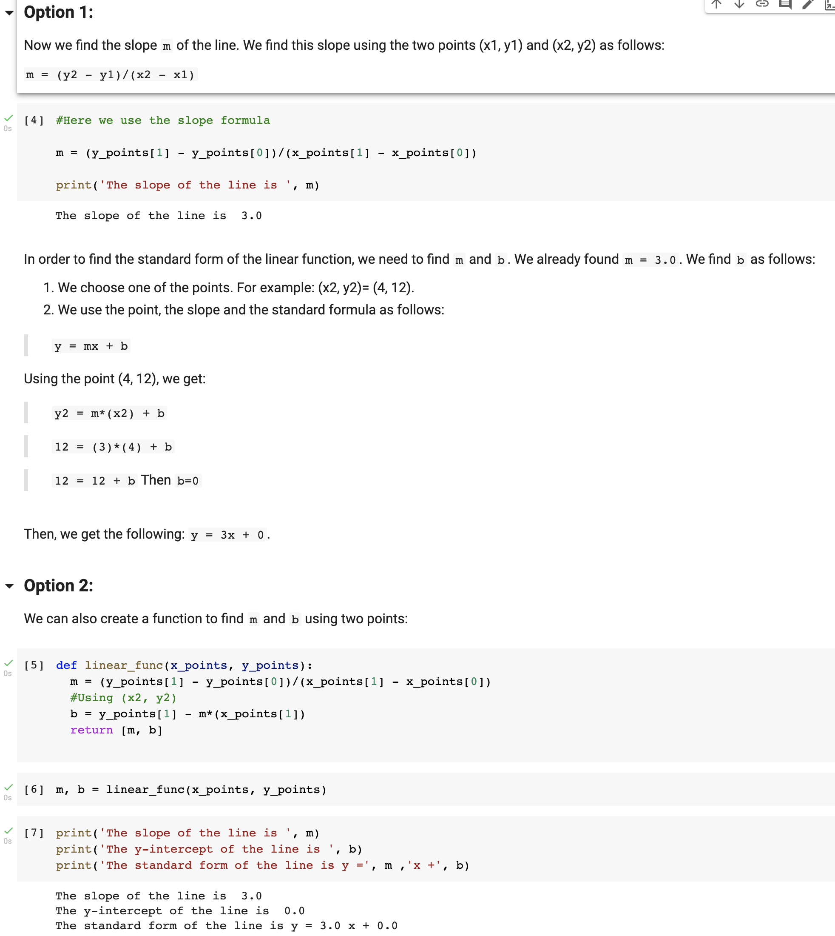

Slide 5
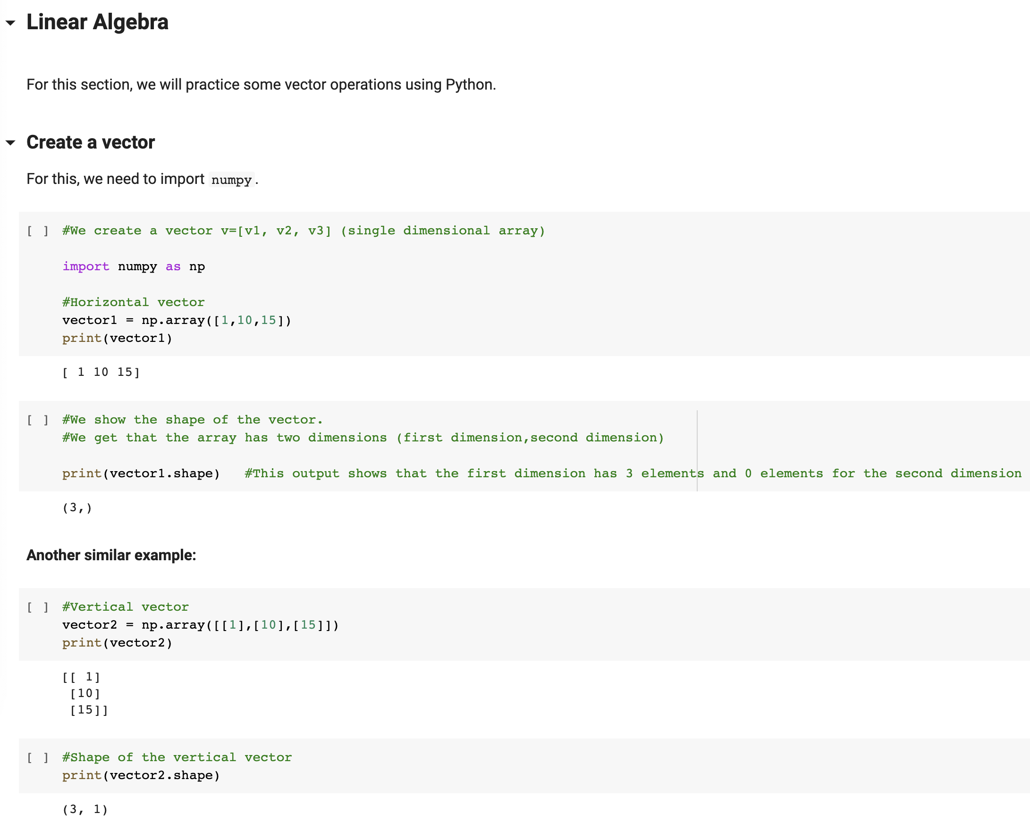

Slide 6
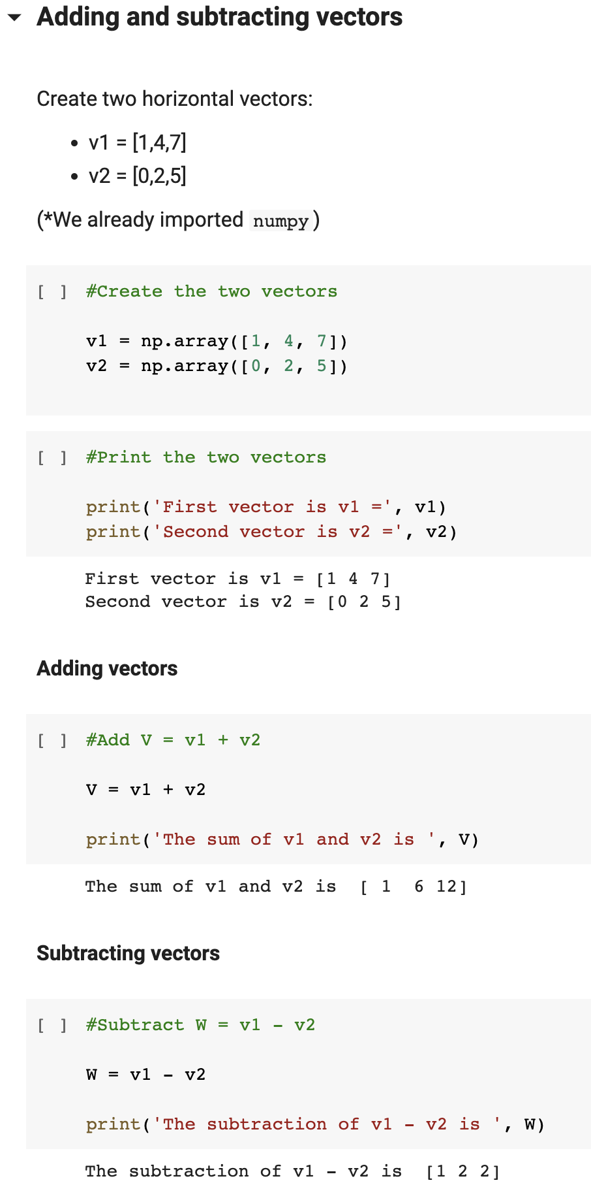
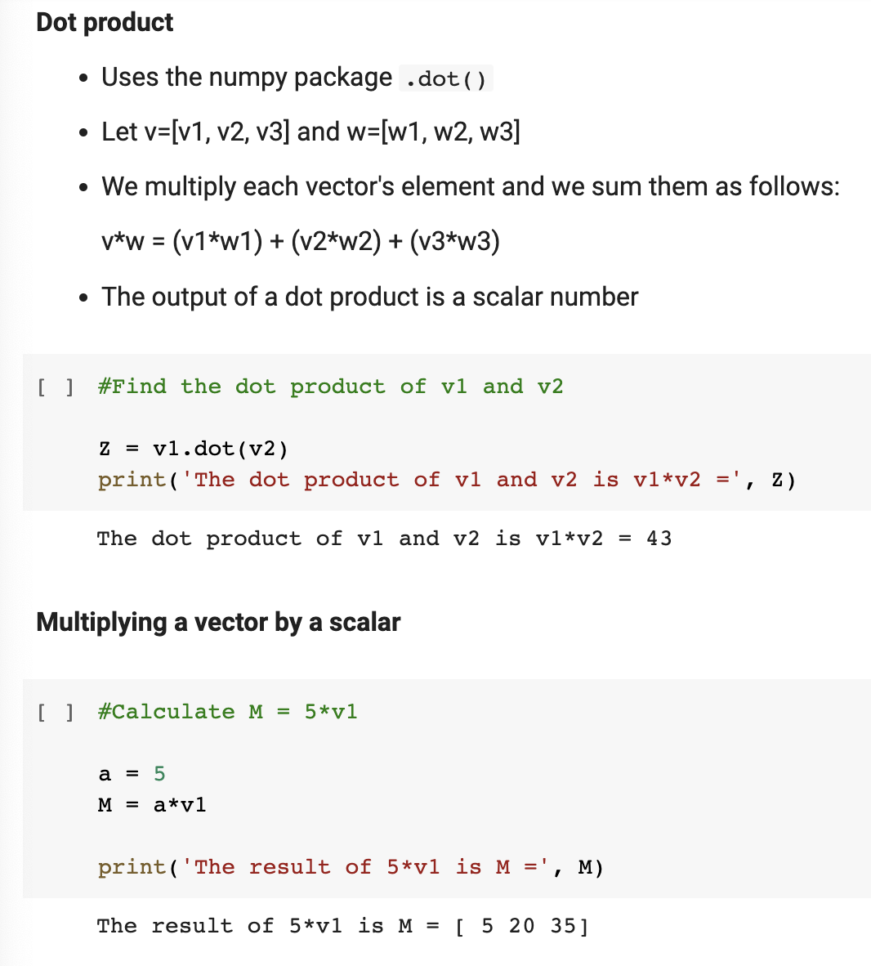

Slide 7
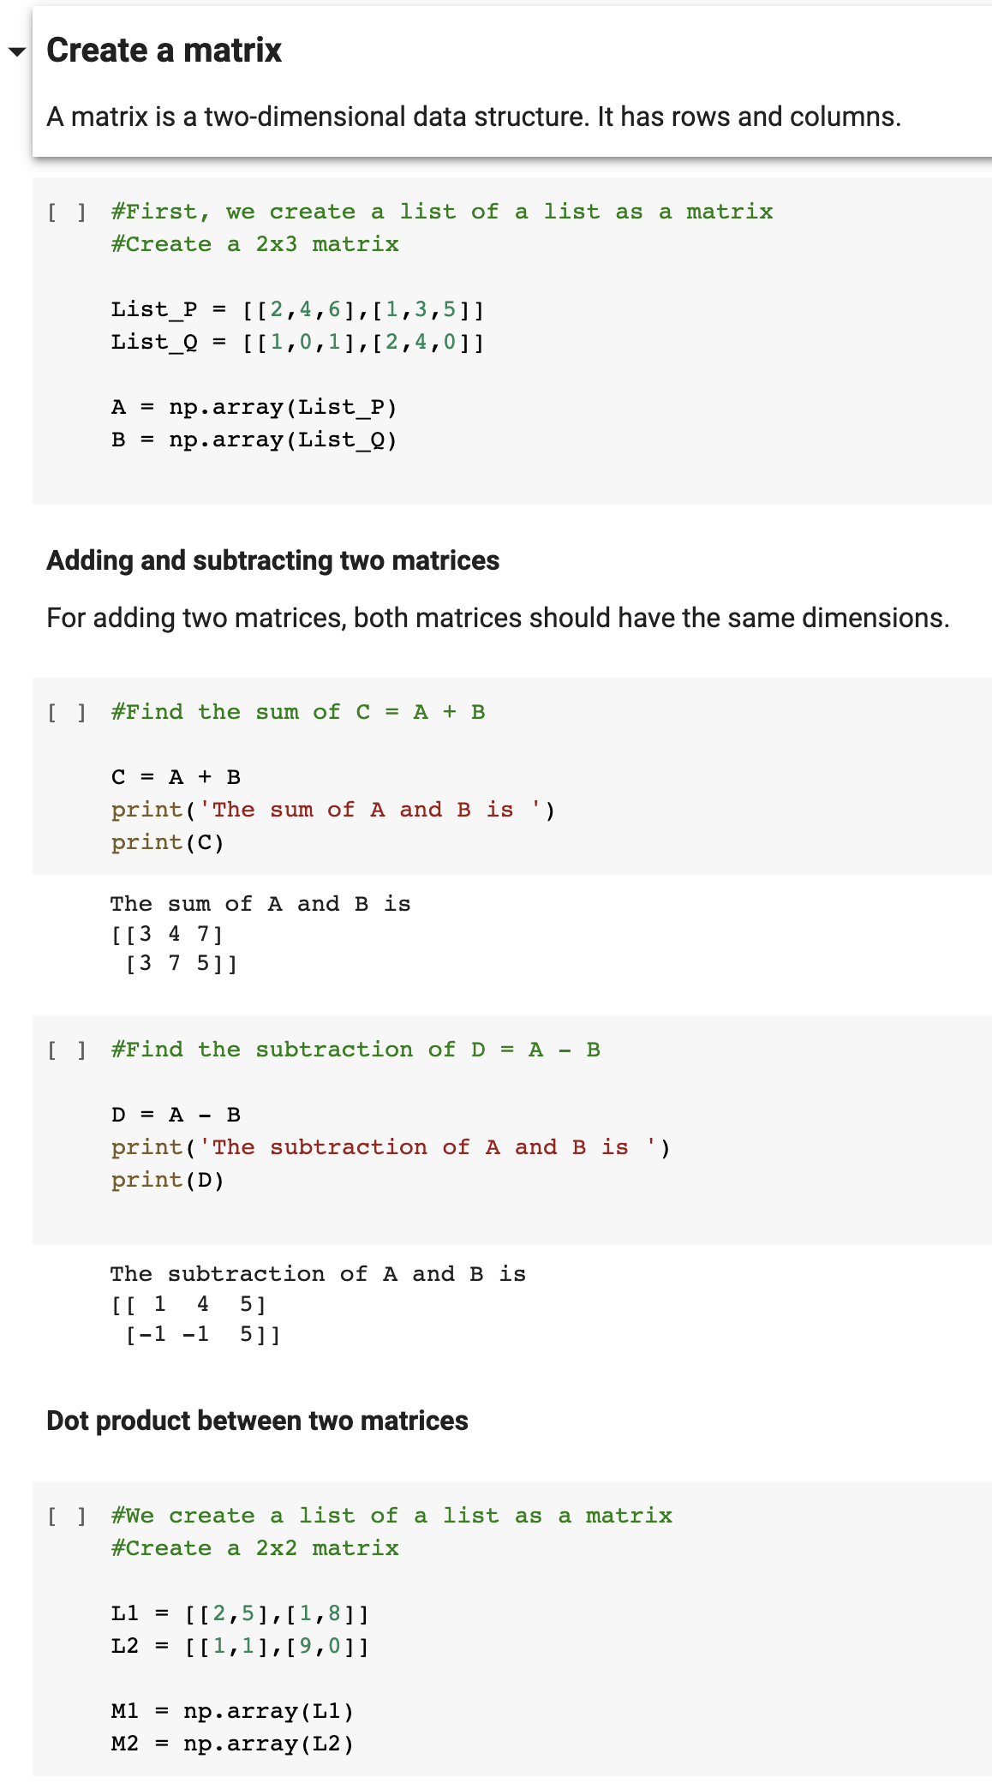
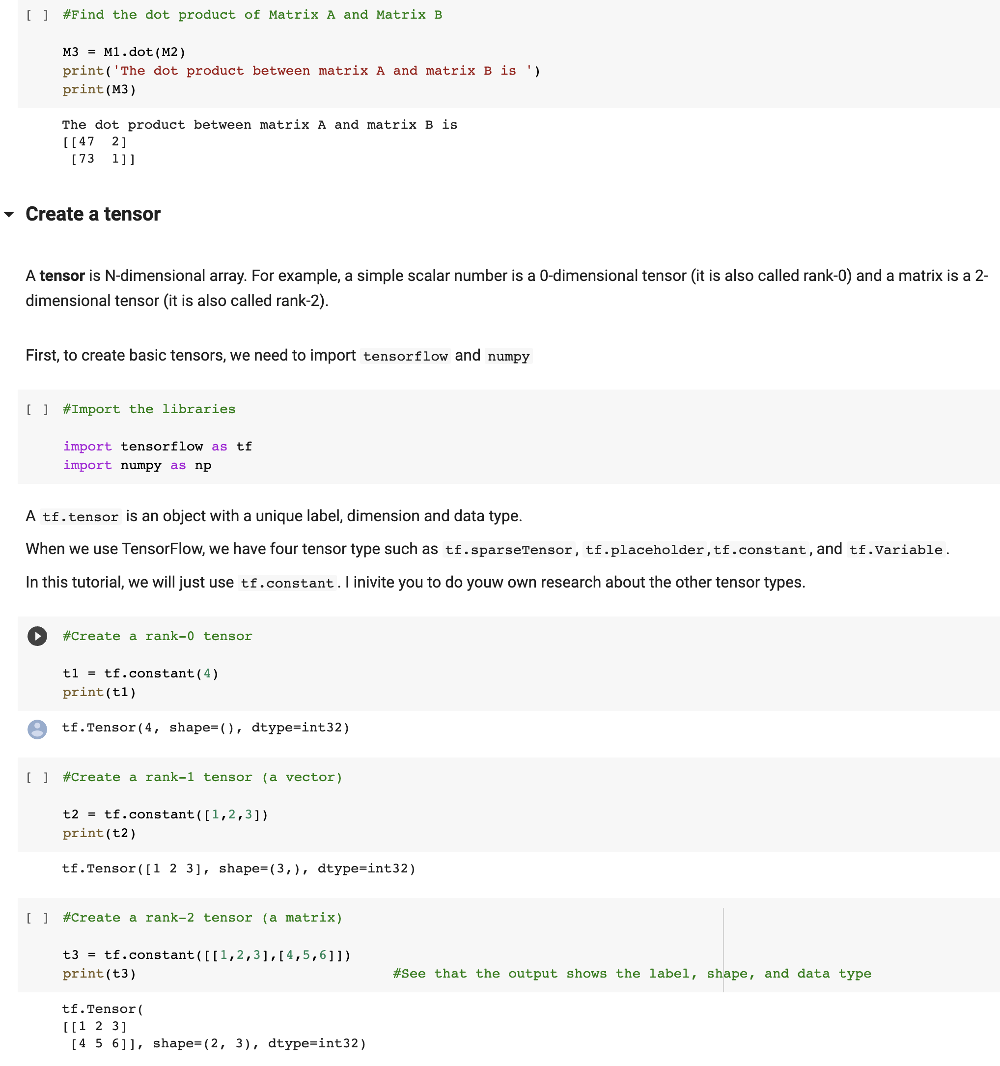

Slide 8

Questions?

